Slide 1
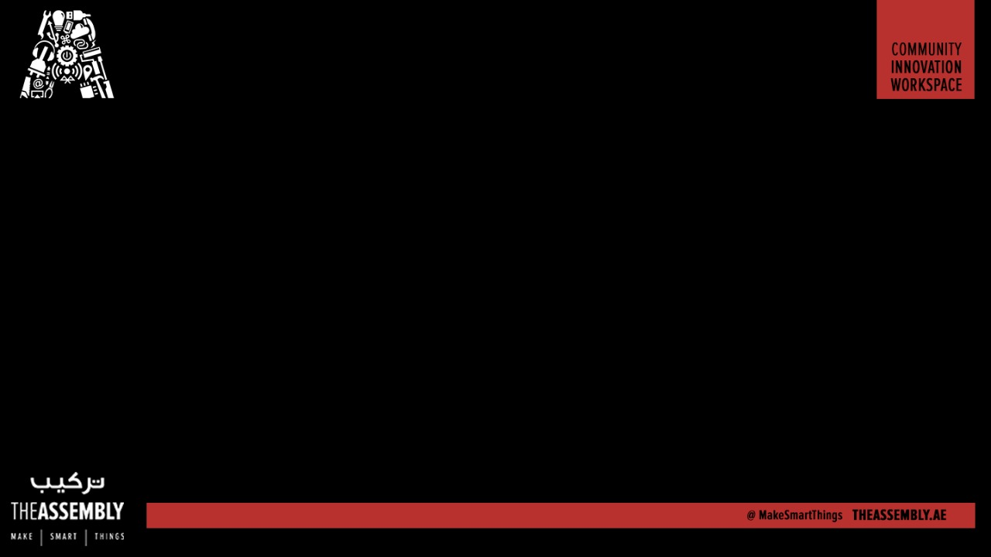
Create a robot rover to follow a fixed path using Raspberry Pi
Presented By : The Assembly Team
WiFi:- In5 Tech
Pass:- WelcomeToIn5

Slide 2
To Do
Learn About Basic Robotics
Learn about Line Following Robot
Assemble it
Code it for Raspberry Pi using Python
Make it Tick

Slide 3
Introduction To Robotics

Slide 4
Input
Processing
Output

Slide 5
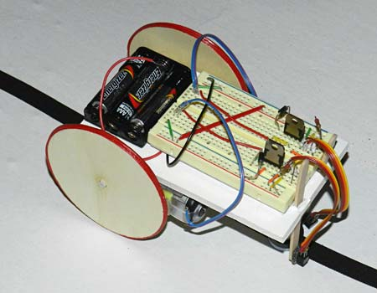
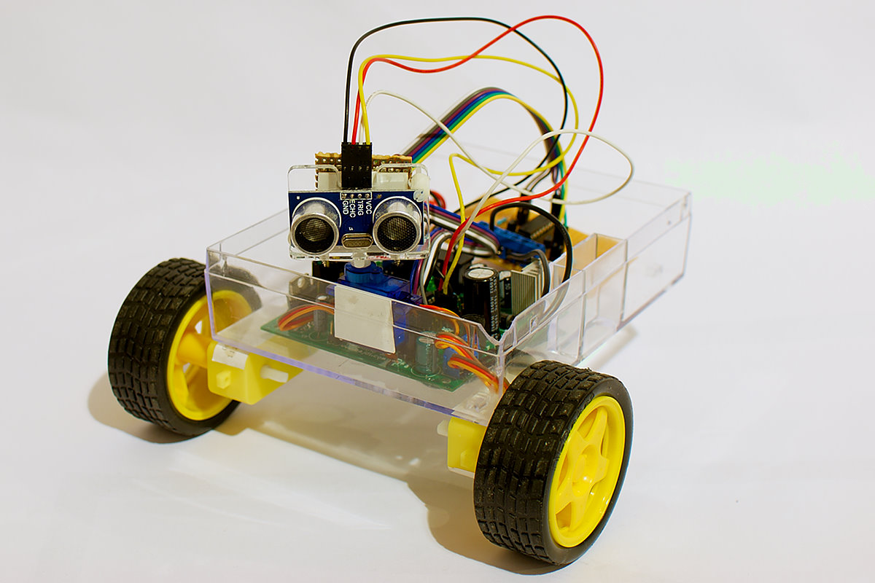
Notes:
*The HC-06 acts as a serial port through which you can send and receive data.
*So using a serial terminal or a Bluetooth customized application on your computer or phone, you can control and monitor your project.
*HC06 functions only as slave to a microcontroller

Slide 6
Line Following Robot

Slide 7
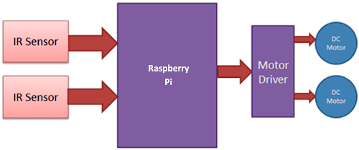
Infra Red Module

Slide 8
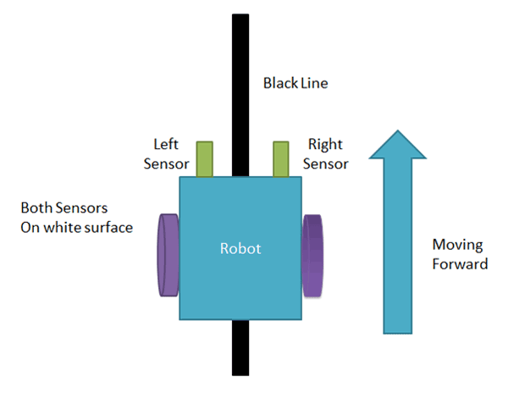

Slide 9
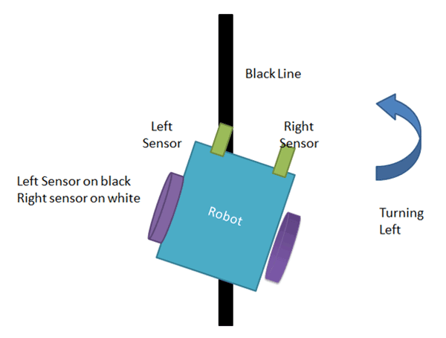

Slide 10
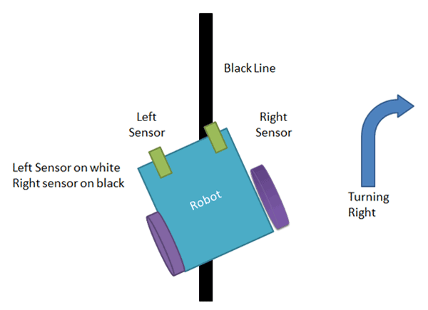

Slide 11
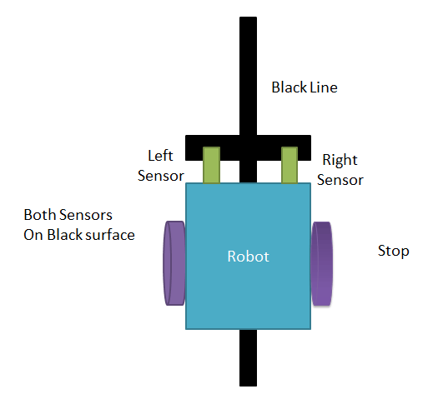

Slide 12
Components

Slide 13
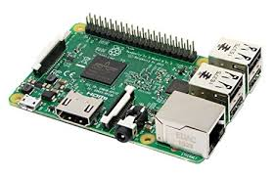
Raspberry Pi
1.2Ghz quad core CPU
1gb DDR2 RAM
4USB Ports
No Memory

Slide 14
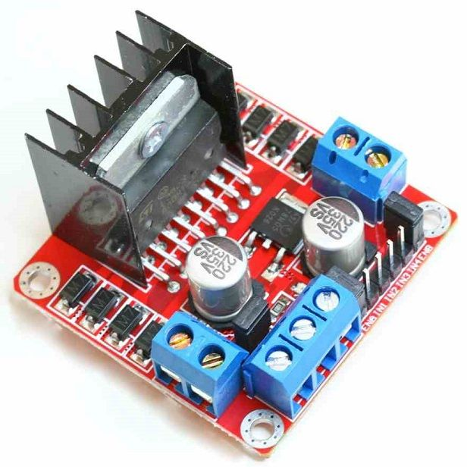
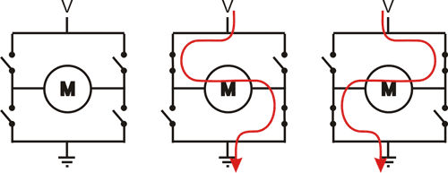
L298N Motor Driver
Notes:
Polylactic Acid (PLA)
Acrylonitrile butadiene styrene (ABS)

Slide 15
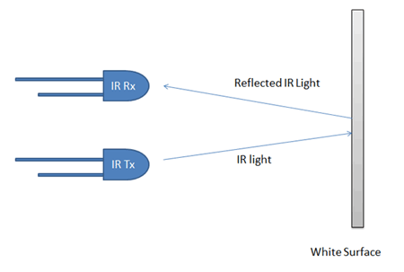
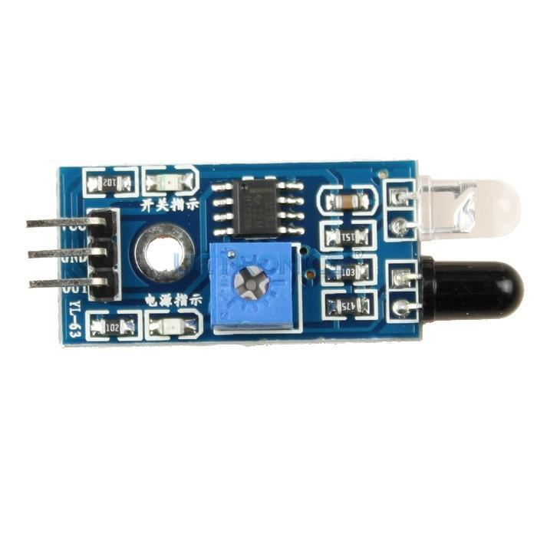
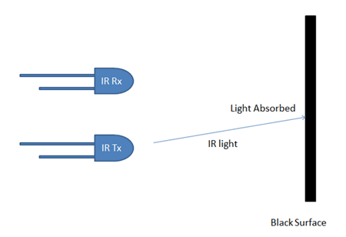
InfraRed Modules

Slide 16
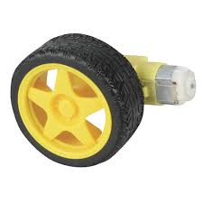
Geared DC Motors

Slide 17
Fritzing Diagram Goes Here

Slide 19

THANK YOU

